Slide 1
Homework Assignment #2
-- due: Nov 2, 10:20am
2.1 Textbook p. 196, Problem 3.2.
2.2 Textbook p. 197, Problem 3.13.
2.3 Write a program for histogram equalization, and test it with your selfie took in a relatively dark environment so that we can clearly see the effect of histogram equalization in image enhancement. Please show the histograms of your selfie before and after histogram equalization and explain your results. (You are not supposed to call the function of histogram equalization directly.)

Slide 2
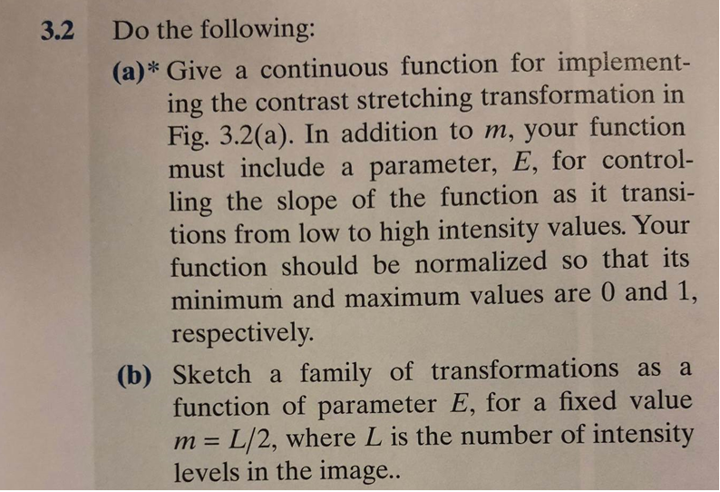
2.1 Textbook p. 196, Problem 3.2.

Slide 3
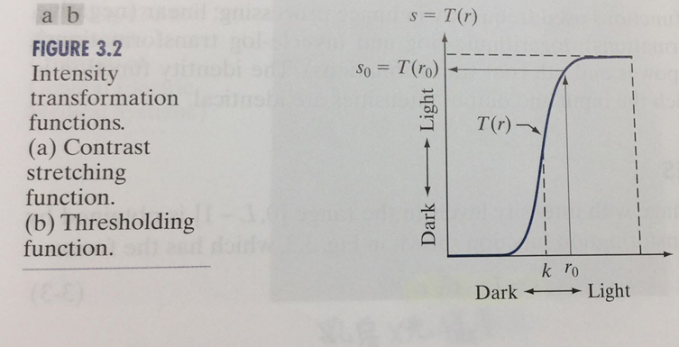
Fig.3.2(a)

Slide 4
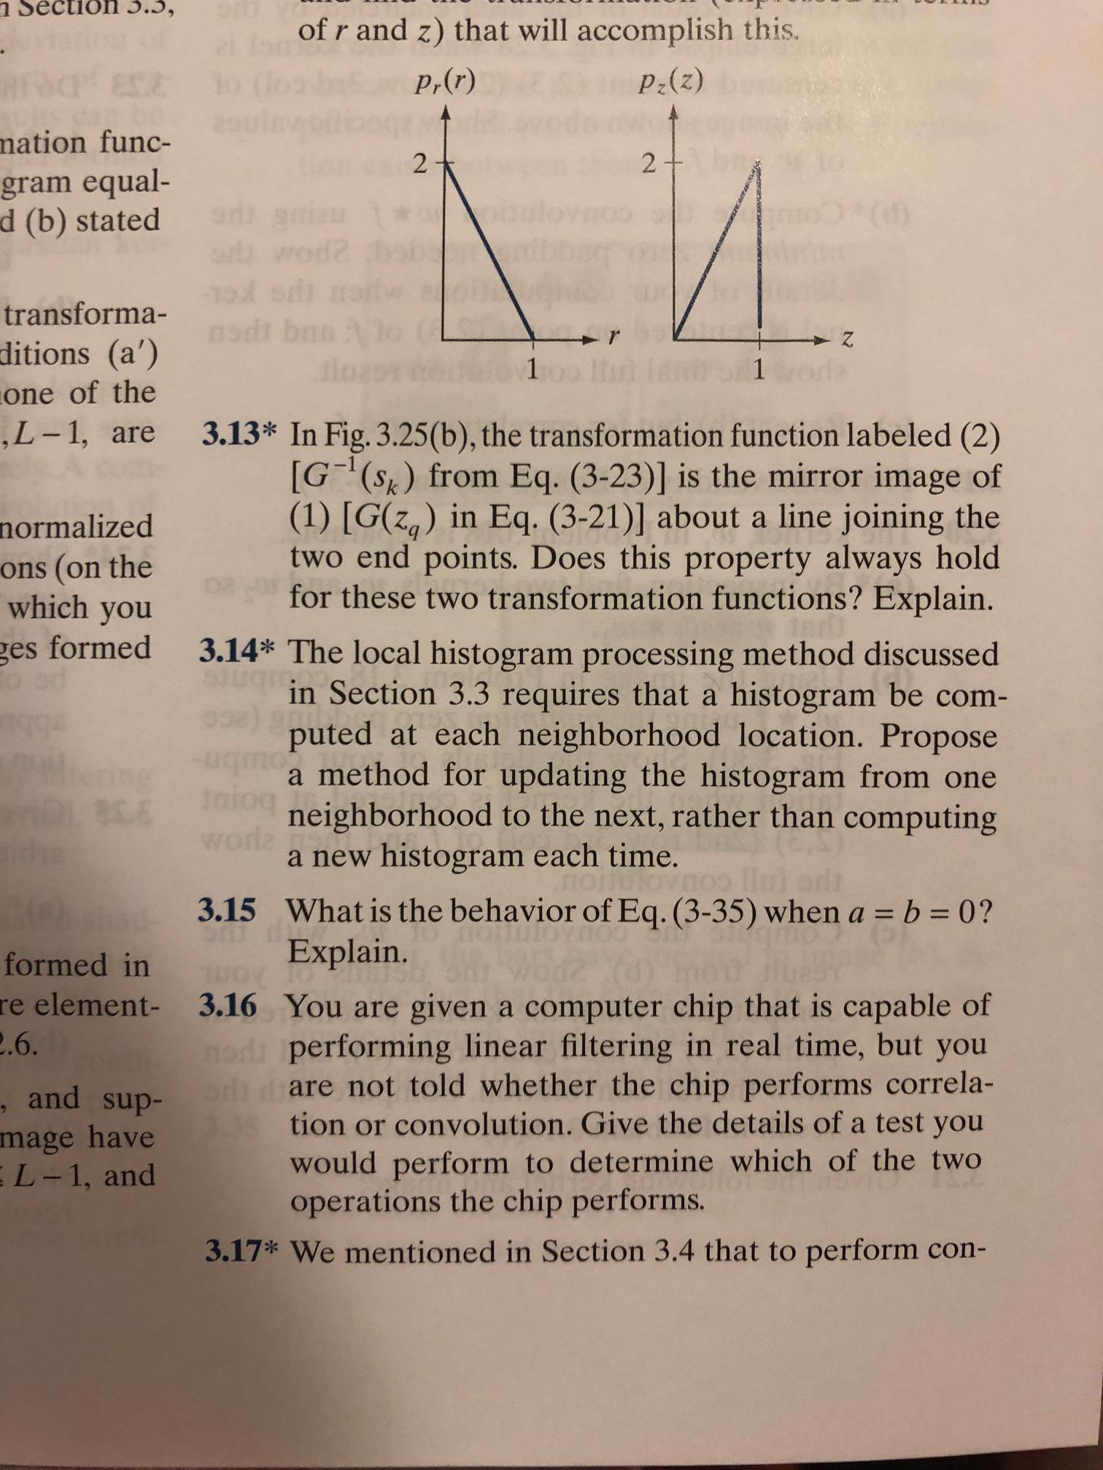
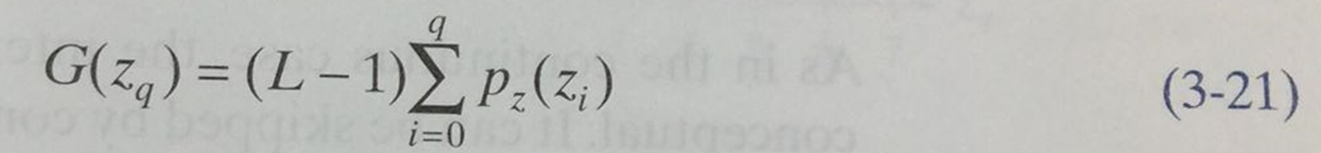
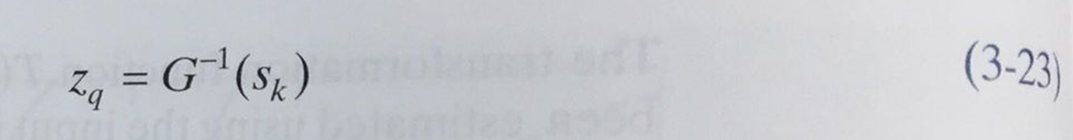
2.2 Textbook p. 197, Problem 3.13

Slide 5
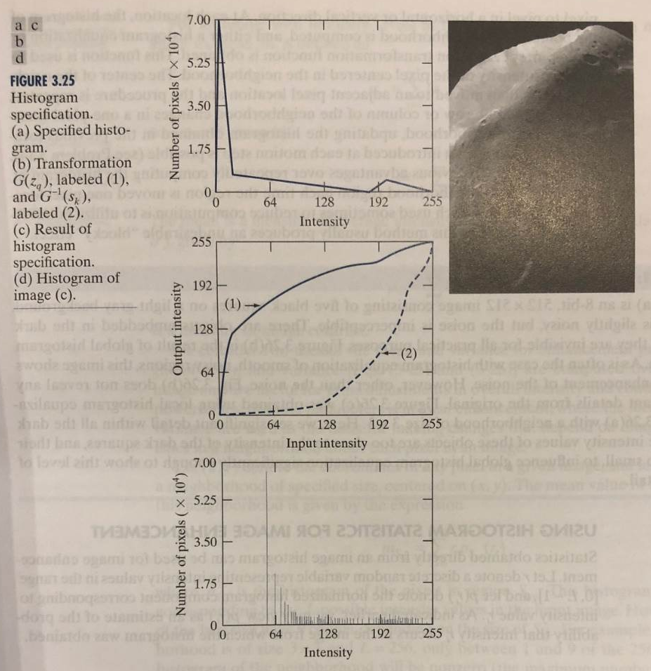
Fig.3.25

Slide 6
Language for Implementation
C, C++, Python, JAVA or Matlab
(If you want to use other languages, please contact TAs. We need to make sure we can run your program!)
For HW 2.3, you need to show how to use your program

Slide 7
Submission
Please submit a .zip/.rar file to ceiba, containing
  Project(source code and execution file)
  Report(.pdf file)
Late submission:
  within 24 hours after its due will incur 20% penalty,
  after 24 hours and within seven days of its due will incur 50% penalty, and
  after seven days of its due will not be graded.
  Note: One minute late is the same as 23 hours late.
DO NOT COPY OTHER’S HOMEWORK!!

